Slide 1

General meeting 6/10 2022
Sjur Beyer

Slide 2
Overview

Slide 3
The Git environment
I changed from using Otokens to having a SSL based git connection. If you are added as a contributor, you should add a SSL key to your github account if you want to clone the repository.

Slide 4
Current status for the models
I have ran some 1D reconstruction models;
Focusing on getting good procedures for running the models on the servers
Profiling:
I did not get very good results for running on Odin. My laptop performed better; Probably because tf ran things in parallel on the laptop graphics processor (much better parallel compute)

Slide 5
Plan
Running models - meanwhile writing theory
Depending on results change things underway

Slide 6
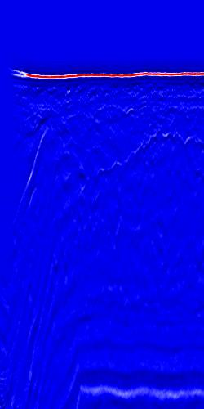
Data cleaning
The left-most side of the image contains some anomalous data which can distract the ML training
These traces should be removed from the data set

Slide 7
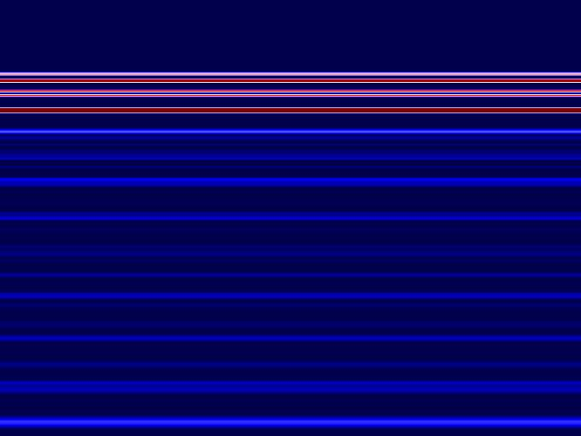
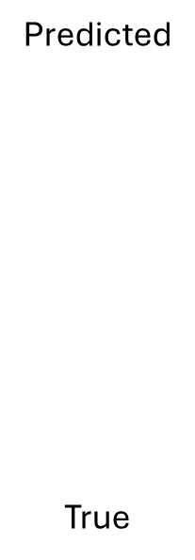
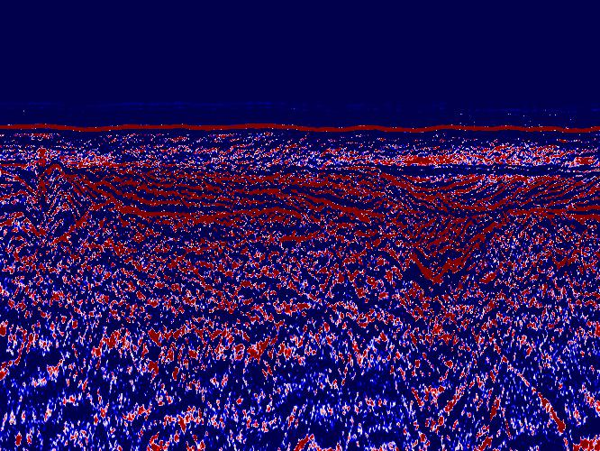
Initial results
Testing out reconstructing the seismic data with 1D TCN
Model converges to some sort of average
NB! These plots are not normalized
Config:
nb_filters = 64
Kernel size = 3 ( which may explain a lot)
Dilations = [1, 2, 4, 8, 16]
batch_size = 20
Epochs = 10
Loss approx. 3

Slide 8
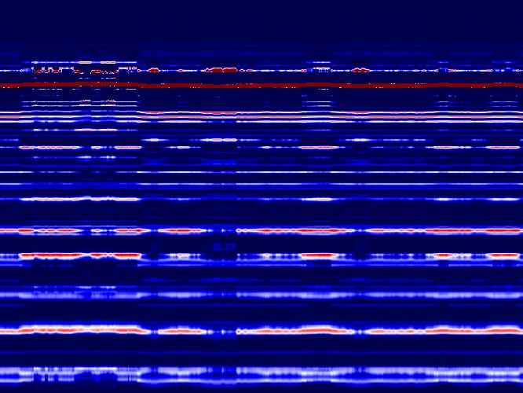
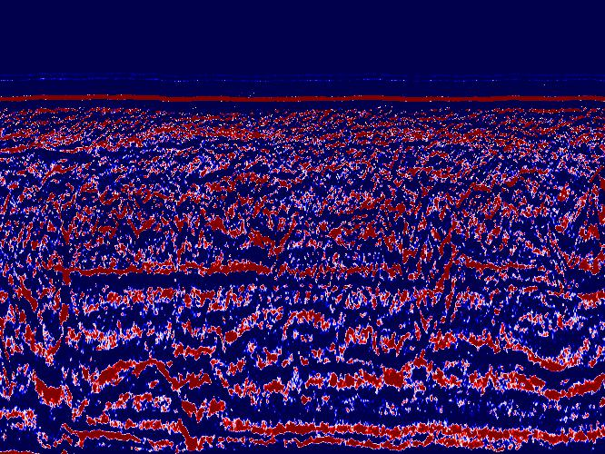
2nd try
This one was able to capture the ocean bottom reflector pretty well.
Config:
nb_filters = 64
Kernel size = 8
Dilations = [1, 2, 4, 8, 16, 32]
batch_size = 20
Epochs = 10
Loss = 1.28
Predicted
True

Slide 9
Optuna
Config:
nb_filters =
Kernel size =
Dilations =
batch_size =
Epochs =
Loss =
Predicted
True

Slide 10
All of this is before any data preperation
Data prep will most likely improve results:
Removing outliers
Normalizing the data

Slide 11
Misc
Causal padding is not supported for Conv2D
Discussion around this

Slide 12
Academics and writing
I’m collecting good sources, and outlining the structure of what is to be written. I’m planning to get a lot of writing in while the models are running

Slide 13
Hardware
More GPU power
Having a GPU hooked up to my NGI laptop would drastically speed up training time
CPU vs. GPU wrt. Odin
Azure cluster
Amazon Web services
$$$

Slide 14
Next meeting
13.10.2022: Geotechnics & geophysics meeting
Topics of discussion:
Parameters for prediction
Data treatment
Good sources
etc..

